Slide 1
Multimedia Systems
Dr Laura Toni
l.toni@ucl.ac.uk
University College London

Slide 2
Today Lecture
Introduction to Information compression
Source Coding
Information and Entropy
Variable length coding
Quantization
Multimedia Systems
Image and Lossy Compression
Transforms
JPEG Quantization
JPEG Lossless Compression
Video Compression
Motion Compensation

Slide 3
Source Coding
Source Encoding
Lossless
(text, programs)
Lossy
(images, videos)
Run Length Encoding
Huffman Code
Incremental Encoding
Notes:
Two main coding types are used in Mobile Communications
Speech Coding – source coding
Reduces the redundancy to minimise the bandwidth
Error Coding – Channel Coding Techniques
Increase the redundancy to reduce errors and improve reliability

Slide 4
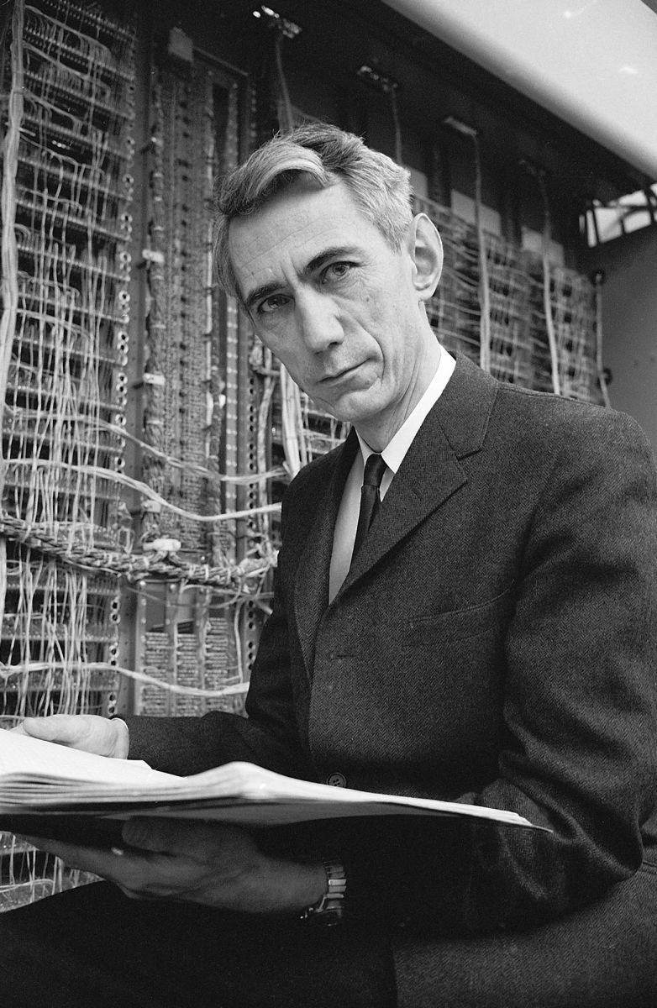
Source Coding
Source Encoding
Lossless
Lossy
Speech and Video coding
D
R
Shannon’s first theorem (1948)
Source recovered with a distortion D (function of the coding rate)
Expected code length relates to the source entropy
Notes:
Two main coding types are used in Mobile Communications
Speech Coding – source coding
Reduces the redundancy to minimise the bandwidth
Error Coding – Channel Coding Techniques
Increase the redundancy to reduce errors and improve reliability

Slide 5
Why do we compress?
These are related to the 3 types of redundancy in images/videos:
Interpixel redundancy
Psychovisual redundancy
Coding redundancy

Slide 6
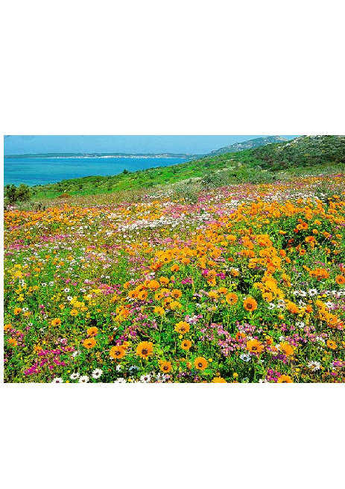
Coding Redundancy
Some colors are more common than others
For example, black, brown, and red hardly appear in this picture
This is sometimes called coding redundancy

Slide 7
Interpixel Redundancy
Blue pixels tend to occur next to other blue pixels; yellow pixels are near other yellow pixels
This spatial correlation is sometimes called interpixel redundancy
There are also interspectral and interframe redundancy

Slide 8
Psychovisual Redundancy
Some parts of the scene are very homogeneous (sky)
Other parts are very busy (flowers) and could hide noise
This is sometimes called psychovisual redundancy

Slide 9
Why Lossy?
Human Visual System Issues
We can get away with lossy compression because your eye doesn’t see everything anyway
Contrast sensitivity function
Mach bands
Spatial masking
Oblique effect

Slide 10

Spatial Masking
A stimulus is harder to see in the presence of large visible spatial and temporal changes in luminance
Line presented near a luminance edge is harder to see as it gets closer

Slide 11
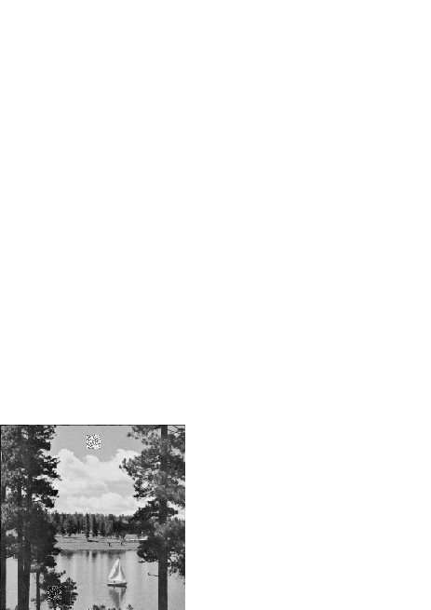
Spatial Masking
Implication: Can allow more error in busy parts of the picture

Slide 12
How well is the compression doing?
We would like to have a low bit rate and yet a high image/video quality
(there are also other factors – not covered today- such as complexity, error resilience, delay etc. )
If you use lossy compression, need to be able to measure the quality

Slide 13
MSE Metric
The most common computable measures are the MSE
where F is the input image, G is the output image, and the images are of size N by M

Slide 14
PSNR Metric
The MSE is often reported in logarithmic form as a signal-to-noise ratio:
where D₀ is a normalization factor
D_{o} often chosen to be the square of the maximum possible input value (e.g., 255²)
Then it’s called a “peak SNR” or PSNR

Slide 15
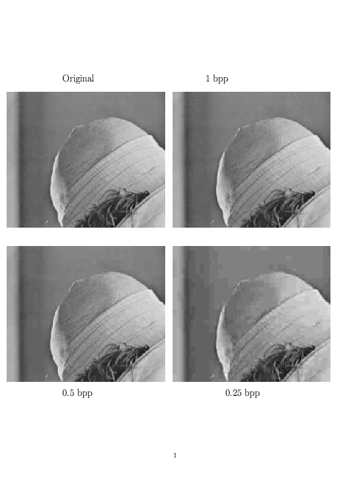
JPEG Example

Slide 16
Thank You

